Slide 1






International Conference on Intelligent Systems and Artificial Intelligence Applications
ISAA 2026
Smart Agro System for Crop Recommendation Using Deep Learning
Pindi Venkata Nageswara Rao (Presenter), Pagadala Usha, Adapa Nishitha, Chokkapu Rohith
Department of Electronics and Communication Engineering
National Institute of Technology Andhra Pradesh, India
Email: pindivenkat24@gmail.com
Organized by
Sponsors:
April 1-2, 2026 · University of Nizwa, Nizwa, Sultanate of Oman · Hybrid Mode: Virtual & Physical

Slide 2
Presentation Outline
1
Introduction & Motivation
5
Experimental Setup & Datasets
2
Literature Review / Related Work
6
Results & Discussion
3
Problem Statement & Objectives
7
Conclusion & Future Work
4
Proposed Methodology
ISAA 2026 · April 1-2, 2026 · University of Nizwa, Oman · isaa2026@unizwa.edu.om
[Page]

Slide 3

Introduction
Background & Motivation
Modern agriculture is highly dependent on soil characteristics and climatic conditions
Traditional farming practices rely on experience and intuition, often leading to inconsistent and suboptimal crop selection
Farmers struggle to make reliable crop decisions due to unpredictable weather and soil conditions
There is a strong need for an Adaptive Intelligent, data-centric crop recommendation system for precision agriculture
Research Objective: To design a hybrid AI-based system that combines soil image analysis, User-defined soil parameters, and real-time weather data for accurate crop recommendations.
ISAA 2026 · April 1-2, 2026 · University of Nizwa, Oman · isaa2026@unizwa.edu.om
[Page]

Slide 4
Literature Review / Related Work
Traditional ML models (e.g., Decision Tree, SVM, Random Forest) used for crop prediction based on soil nutrients and weather data
Deep learning approaches (CNN) applied for soil image classification to identify soil types
Some systems utilize weather-based recommendations, but lack integration with soil characteristics
Most existing methods rely on a single data source, limiting prediction accuracy
Research Gap :
Lack of integration of visual soil image-based information with environmental data
Limited use of hybrid AI models (CNN + Ensemble ML)
Absence of real-time systems combining image + weather + user input
ISAA 2026 · April 1-2, 2026 · University of Nizwa, Oman · isaa2026@unizwa.edu.om
[Page]

Slide 5
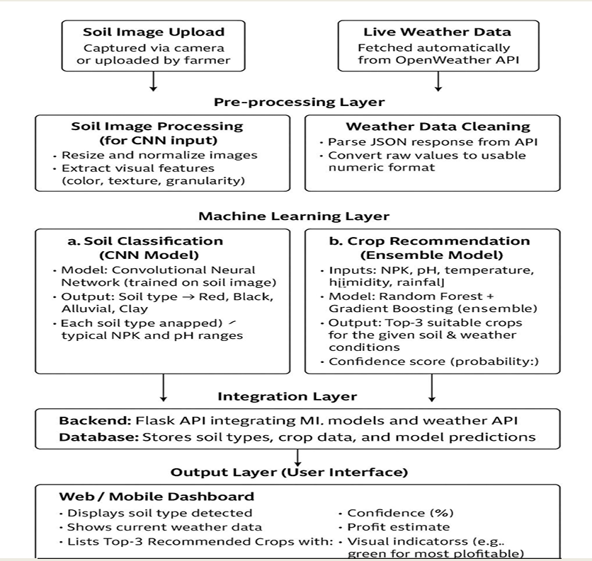
Proposed Methodology
01
Data Collection
Soil Images: 2537 images (5 types), Source - GitHub dataset + web sources
Preprocessing: Duplicate removal, Resize (128×128), Normalize image
Crop Dataset: 2200 samples (22 crops), Source – Kaggle
Preprocessing: Min-Max scaling, Feature normalization (N, P, K, pH, temp, humidity, rainfall)
02
Model Design
CNN: classifies soil and maps it to NPK & pH profile
Inputs: soil image + weather data + optional user-input
Ensemble model (Random Forest + Gradient Boosting) for prediction
Outputs: Top 3 crops with confidence and profit estimation
03
Evaluation
CNN performance: ~97% train, ~95% validation.
Loss reduced consistently indicating stable training with minimal
Models compared: RF(99.32%), GB(98.18%), SVM(96.82%), KNN(95.91%), DT(98.18%)
Optimal Model: Ensemble of RF (99.32%) + GB (98.18%)
RF reduces variance through bagging & GB reduces bias by sequentially correcting errors
Metrics: Accuracy, Confusion Matrix, ROC Curve
ISAA 2026 · April 1-2, 2026 · University of Nizwa, Oman · isaa2026@unizwa.edu.om
[Page]

Slide 6
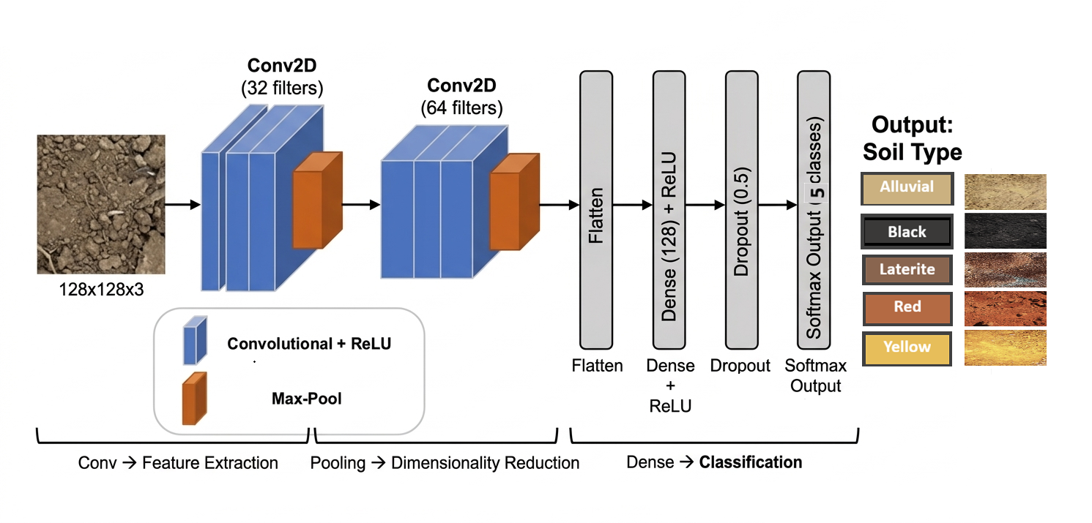
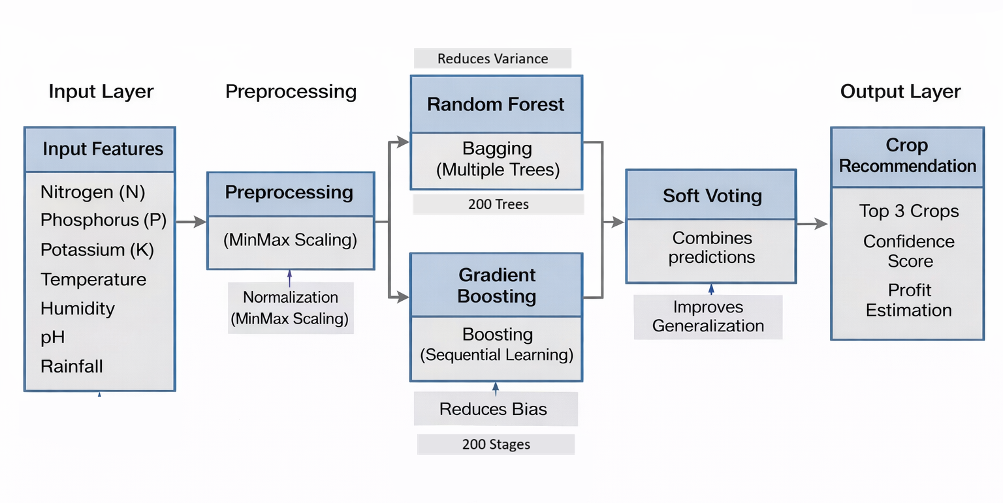

Overall Architecture of Smart Crop Recommendation System
CNN-Based Soil Classification Architecture
Crop Recommendation using Ensemble Learning (RF + GB)
Soil Image
ISAA 2026 · April 1-2, 2026 · University of Nizwa, Oman · isaa2026@unizwa.edu.om
[Page]

Slide 7
Experimental Results
99.3%
0.99
0.99
4,737
(Soil: 2537, Crop: 2200)
Accuracy
(Test Set)
F1 Score
(Macro Avg)
AUC-ROC
(Proposed Model)
Dataset Samples
Method | Accuracy | F1-Score | AUC
Baseline (Traditional ML) | ~95% | 0.94 | 0.95
Individual Model (RF) | 99.32% | 0.99 | 0.99
Proposed Method (Ensemble RF + GB) | ≈99.3% | 0.99 | 0.99
Ensemble improves robustness and consistency, not just accuracy
ISAA 2026 · April 1-2, 2026 · University of Nizwa, Oman · isaa2026@unizwa.edu.om
[Page]

Slide 8
Discussion & Analysis
Key Finding 1
Key Finding 2
The proposed system achieved high accuracy with CNN (~95%) and ensemble ML (~99%)
Integration of soil images, weather data, and user-input parameters significantly improved prediction reliability
Core Insight: combining visual soil features with environmental data leads to more accurate crop recommendations than traditional methods
Incorporation of real-time weather data enables adaptive and context-aware recommendations
Ensemble approach (RF + GB) improves stability and generalization compared to individual models
Core Insight: A hybrid AI framework (Deep Learning + Ensemble ML) provides more robust and reliable predictions than standalone approaches
Limitations
Future Work
Dependency on internet connectivity for real-time weather API
When only an image is provided, soil nutrient values are derived from standard agronomic databases and represent typical soil profiles, not exact field measurements
Limited size and diversity of the soil image dataset
Model performance may vary across different regions and soil conditions
Integration of IoT-based soil and weather sensors for real-time nutrient and weather monitoring
Improve soil classification by leveraging advanced feature learning from soil images (texture, structure, Moisture )
Development of a mobile application for easy farmer access
Support for offline/edge deployment in low-connectivity areas
Expansion with region-specific and larger datasets for better generalization
ISAA 2026 · April 1-2, 2026 · University of Nizwa, Oman · isaa2026@unizwa.edu.om
[Page]

Slide 9
Conclusion
Core Contribution: Developed a hybrid AI system combining CNN + Ensemble ML for intelligent crop recommendation
Impact: Achieved ~95% accuracy (CNN) and ~99% accuracy (ML), improving reliability over traditional methods
Novelty: Integrates soil images + real-time weather + user-input, unlike existing single-input systems
Future Direction: Extend with IoT-based sensing, mobile deployment, and region-specific datasets
Acknowledgements: We thank NIT AP for support and Resources.
We thank Faculty Mentor(USHA) for guidance,
and We Acknowledge Public Datasets: GitHub, Kaggle, SoilGrids, ICAR
ISAA 2026 · April 1-2, 2026 · University of Nizwa, Oman · isaa2026@unizwa.edu.om

Slide 10
Contact
Thank You!
Name: Pindi Venkata Nageswara Rao
Affiliation: Dept. of ECE, NIT Andhra Pradesh
Questions & Discussion
Email: pindivenkat24@gmail.com
Organized by
Conference: isaa2026@unizwa.edu.om
Website: unizwa.edu.om/ISAA2026
Sponsors:
OMRAN

